Slide 1
@PennInspire
Jorge (Jay) Ortiz-Carpena
INSPIRE Founder & Co-Director
The Penn Interdisciplinary Network for Scientists Promoting Inclusion, Retention, and Equity
Notes:
First, Thank you Jon for the opportunity to quickly introduce Penn Inspire, which is short for the Penn Interdisiplinary Network for Scientists Promoting Inclusion, Retention, and Equity. I founded Inspire in October of last year, with the vision of creating opportunities within and outside of the Penn ecosystem for those at the margins of Academia.

Slide 2
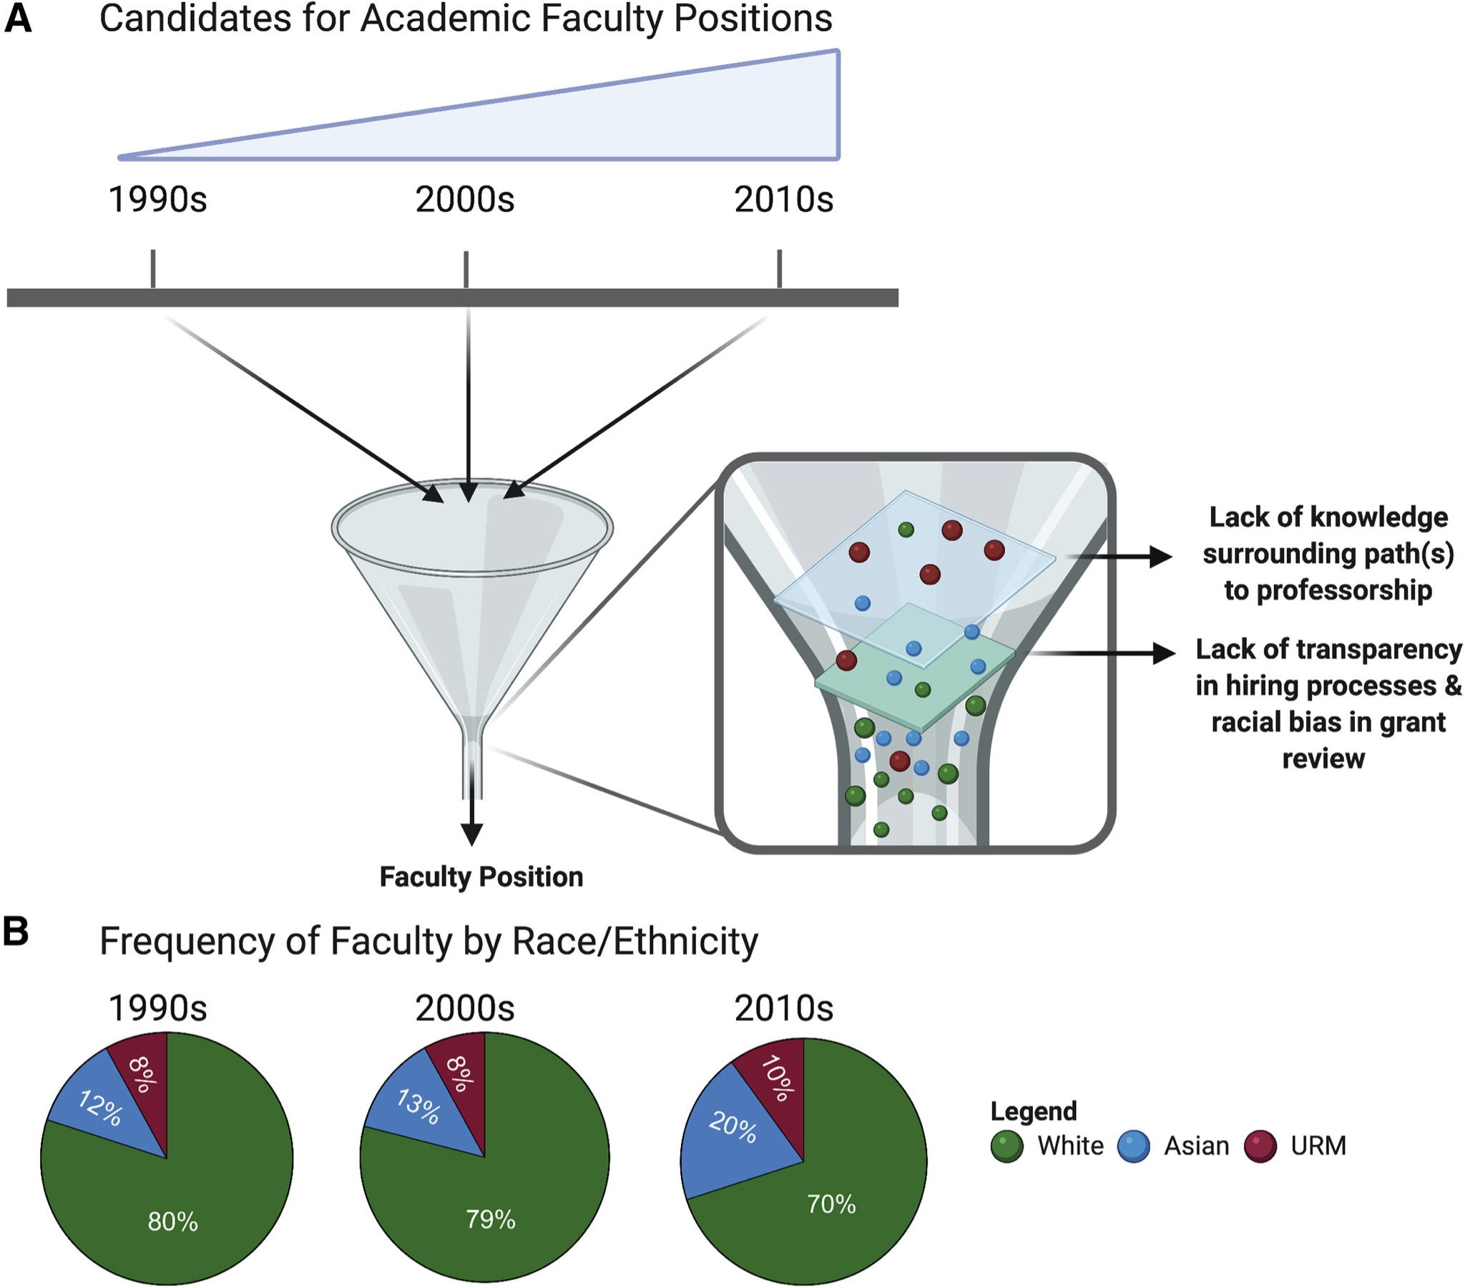
Why did we establish Penn INSPIRE?
Scientists from underrepresented minority (URM) backgrounds, receive 6% of NIH research grants despite making up 32% of the US population.
1
2
As stated in a 2011 report from the National Academies of Science, “diversifying faculties is perhaps the least successful of the diversity initiatives.”
Notes:
So, why create Penn inspire?? Well, one of the problems I think all of us struggle with at some level, particularly in this committee, is the fact that URM MDs and PhDs make an alarmingly small proportion of tenure-track faculty compared their well-represented peers in basic and medical science departments across US medical schools.
And so, even as the proportion of URM PhD graduates has increased 9 fold in the past 40 years, there seems to be a significant gap in the number of URM PhDs that go from postdoctoral positions into tenure track faculty positions. This is clearly exemplified by a 2011 report from the National Academies of Science which states...
I want to highlight our motivation to create Inspire, which we shared on our recent Forum in Cell Host & Microbe. As you surely know, despite the many recruitment and inclusion efforts to foster diversity in academia, URM MDs and PhDs make an alarmingly small proportion of tenure-track faculty compared their well-represented peers in basic and medical science departments across US medical schools.
In our commentary we identified several issues illustrated in this funnel graphic as barriers to access professorship positions. We believe a lack of accountability toward actively addressing these issues has created a futile cycle for URM scientists, where they are encouraged to access training opportunities but are discouraged to establish independence as a faculty member due to systemic barriers in the funding system and hiring processes rooted in unconscious bias and racism.

Slide 3
Our vision to Inspire Penn
Network & Partnership Development
Advocacy & Outreach
Media Engagement
Foster partnerships with organizations within & outside the Penn ecosystem focused on acquiring resources to enable URM scientists to attain positions at the highest levels of influence in the scientific enterprise.
1
3
Promote recruitment of diverse student body in graduate programs and at the medical school. Advocate for an inclusive environment and safe spaces for URM individuals.
2
Highlight the efforts and accomplishments of URM scientists at Penn by establishing partnerships with news organizations within Penn and the greater Philadelphia area.
Notes:
We recognize that there are many moving parts to this issue, we have sought to tackle it through 3 main areas described here to establish a network and umbrella to connect and empower the myriad student organizations already doing fantastic work on campus.
First by promoting the recruitment of a diverse student body, a well as providing safe spaces for discussion for URM scientists.
Second, by establishing strategic partnerships between students, faculty and particularly Penn Postdocs to promote already existing programming as well as creating new opportunities particularly focused on providing URM postdocs with the tools to achieve independence and attain faculty positions.
And third, One area that I think really sets us apart is our media engagement strategy. We are partnering with media organizations across Penn and the greater Philadelphia Area to highlight the efforts of URM scientists.

Slide 5
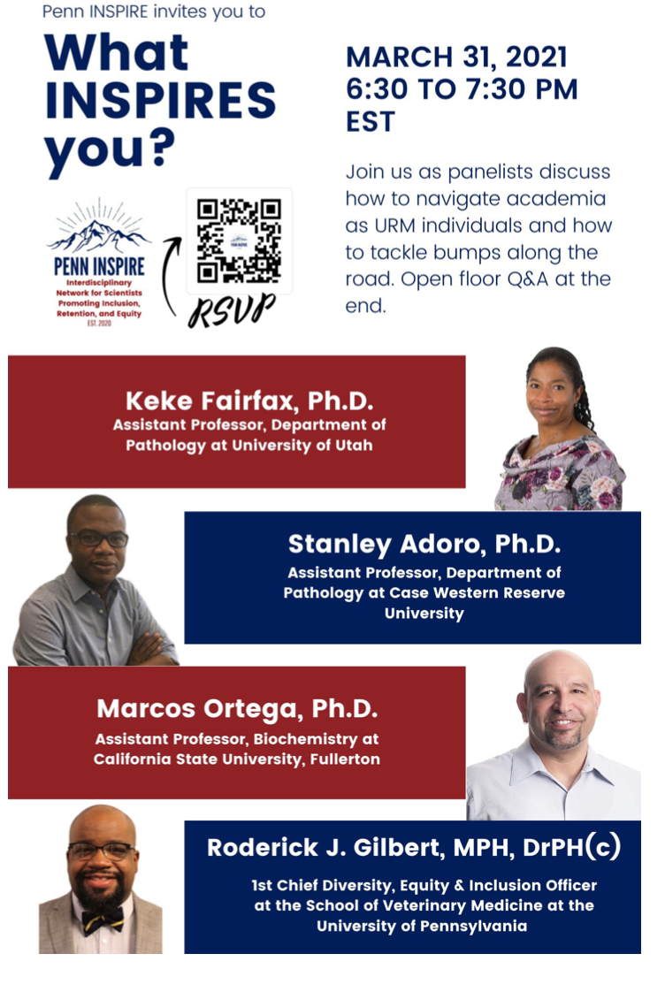
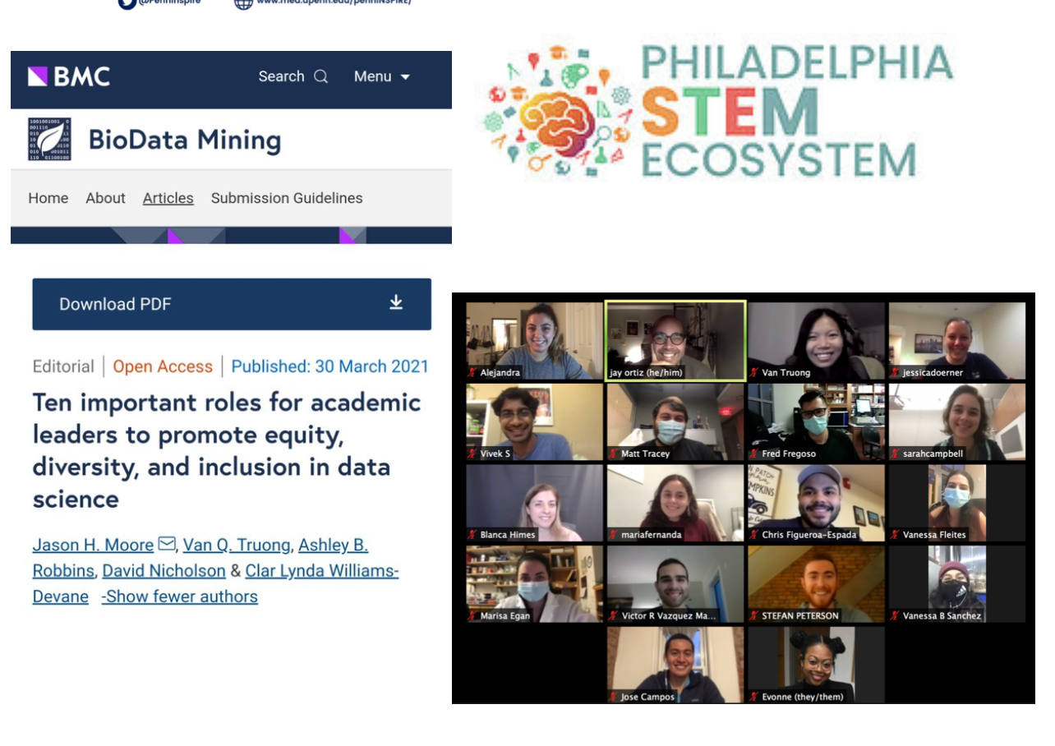

Slide 6
Join us!
Notes:
CLICK

